Slide 1
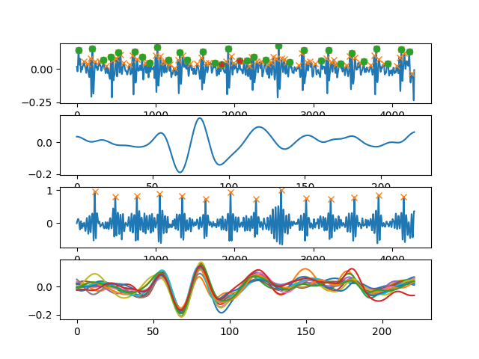
Heartbeat detection with IMU

Slide 2

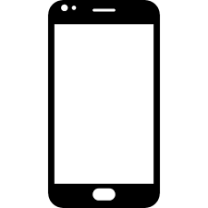
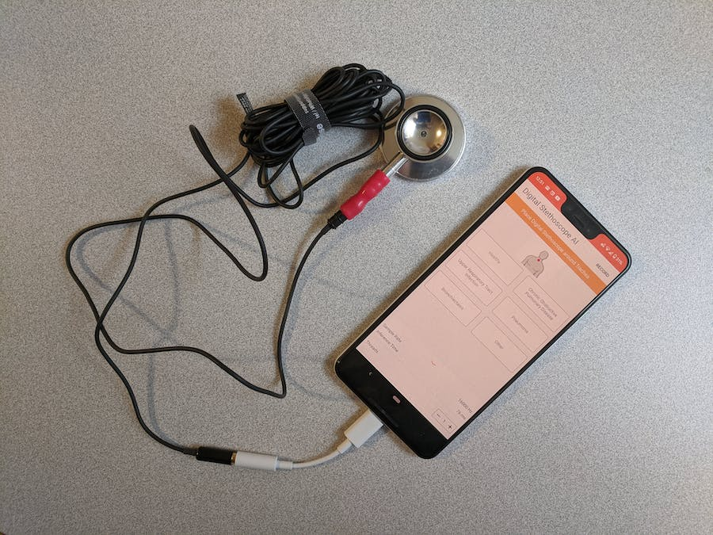
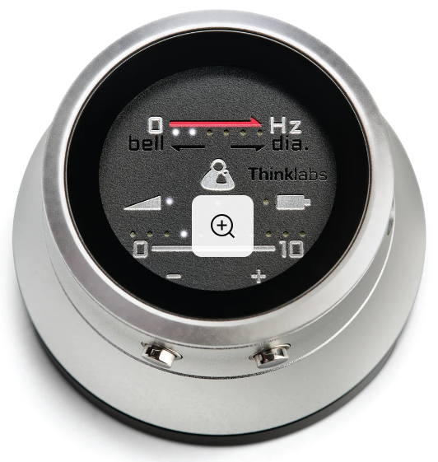
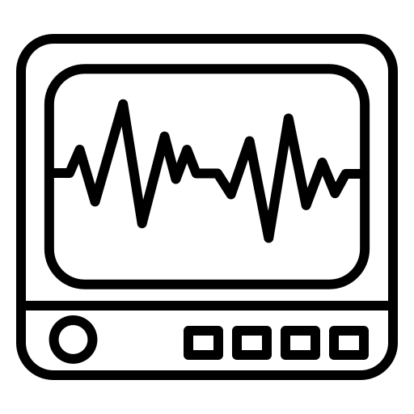
Smartphone as Stethoscope
PCG
Mobile
Low-end
High-end
ECG
Better
MIC
PCG
IMU
How to improve PCG recording?
Measurement: drawbacks of mobile device.
Extra information from IMU, PPG.
Data scarcity if deep learning.
PPG

Slide 3
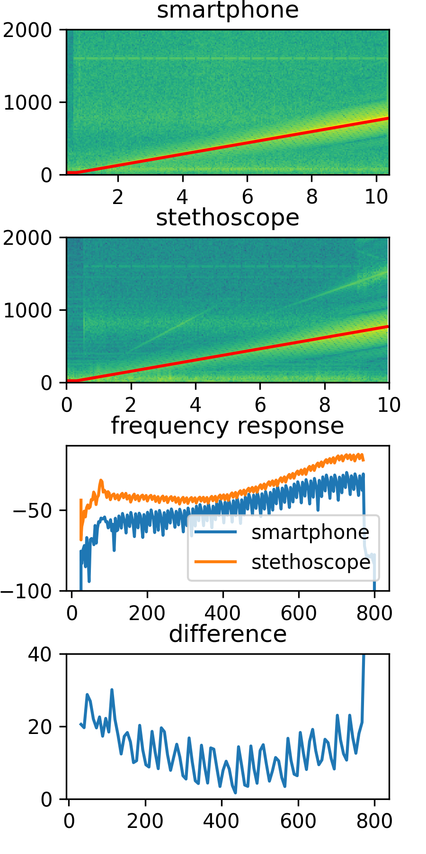
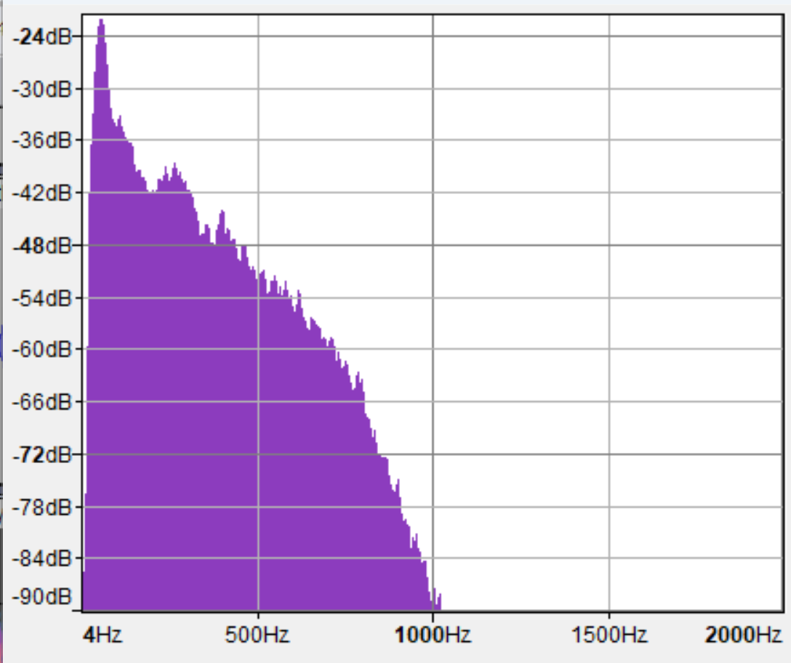
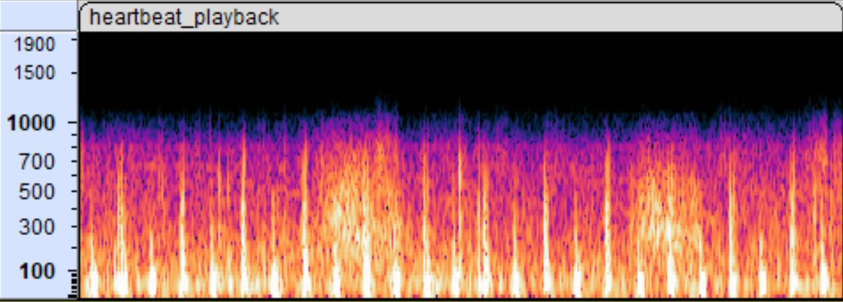
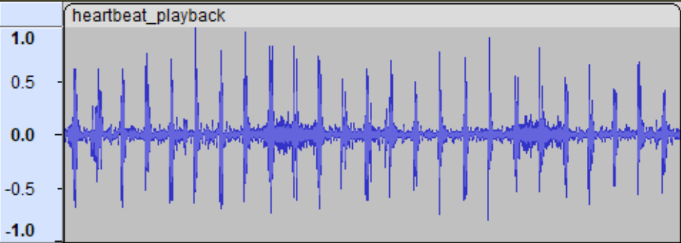
Measurement
Heart sound sample
Stethoscope has higher gain
The advantage is more obvious in low-frequency band, which is also the main components of heart sound.
IMU (low-pass filter) may help!

Slide 4
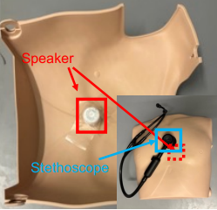

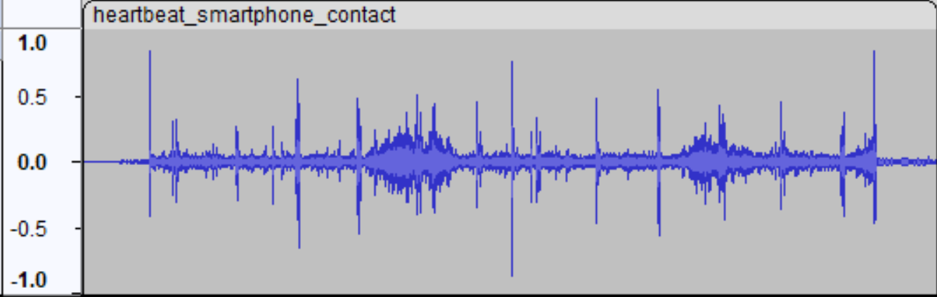
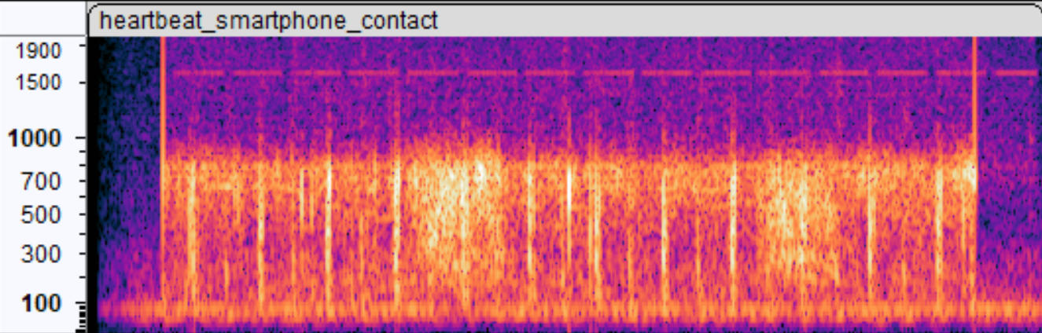
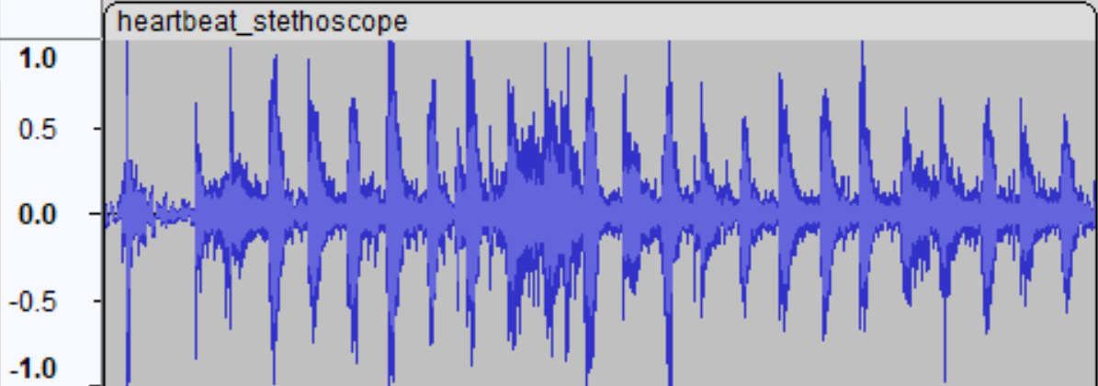
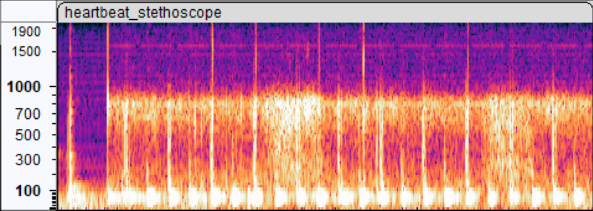
Heart sound playback
Or
Speaker
Version
ARSteth @IPSN’23

